Slide 1

CLUSTERING Global development
P456-6th group

Slide 2
BY :- P456 BATCH : GROUP 6TH
Akshata Shivarai
Chenna Kesava Reddy Bhomireddy Gari
Vyshnavi Nallagopu
Swati Sujit Deokar
Shinde Sanjana Bhaskar
Shanmukh A Chinmalli

Slide 3
INTRODUCTION :-
Objective:
To group countries based on development metrics using clustering techniques.
Analyze patterns and provide insights for global economic and development strategy.
Significance:
Helps policymakers understand country-level development clusters for targeted actions.

Slide 4
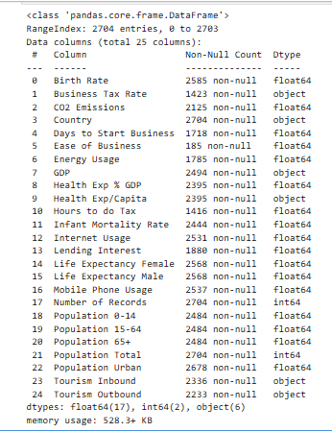
Exploratory Data Analysis
Info of variables present in the dataset -

Slide 5
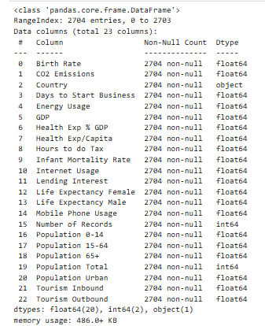
Identifying which variable has highest missing values-
If a variable contains highest missing values and if it doesn’t affect our analysis then we can drop those variables.
If the variable is crucial for our analysis then we will be replacing it with mean or mode.
For numerical variables- Mean
For categorical variables-Mode

Slide 6
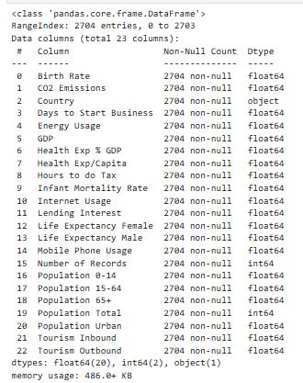
Type Conversion-
We want all columns to have numeric data types. Currently, GDP, Tourism Inbound, and Tourism Outbound are in object data type. Hence, we are converting these object columns into the required numeric data types for accurate analysis and computation .

Slide 7
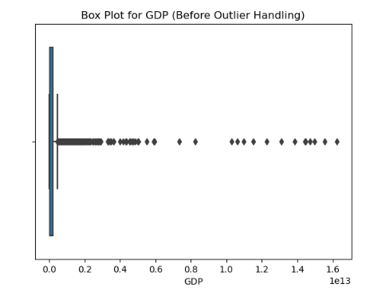
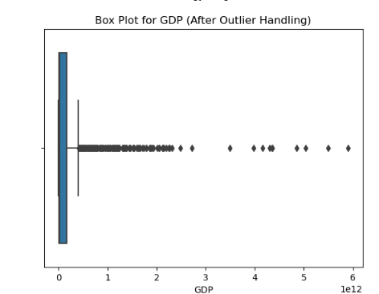
Identifying and handling outliers-
For instance, considering GDP variable,

Slide 8
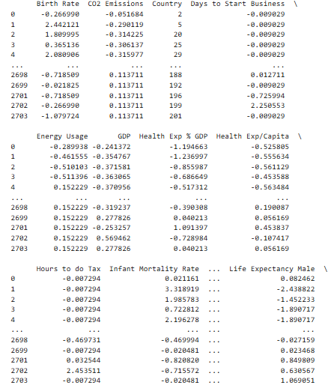
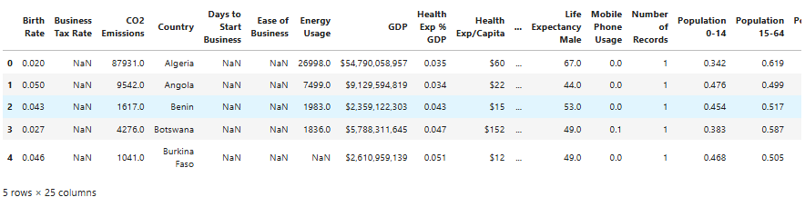
Data preprocessing-
For numerical columns- Applied Standard Scaler.
For categorical columns –Applied Label encoding.
Before data preprocessing,
After data preprocessing,

Slide 9
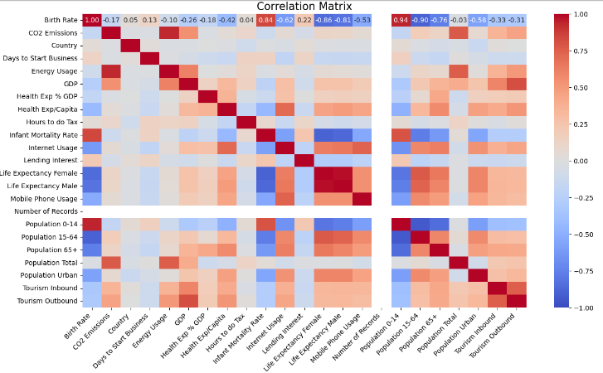
Correlation Matrix:

Slide 10
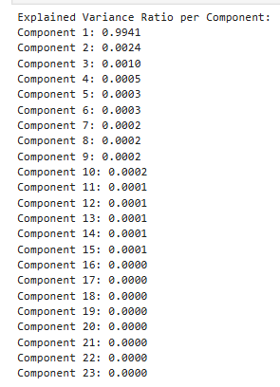
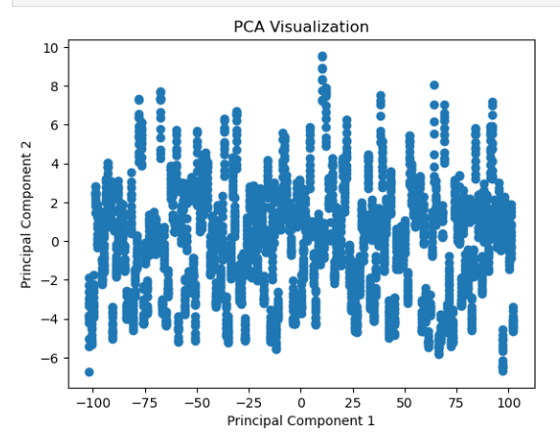
Checking whether any data loss after applying principle component Analysis-
Here we are checking data loss using variance ration after applying PCA method...

Slide 11
Models verified-
Here we applied different types of clustering models like:
K- Medoids
Fuzzy C-Means
K-Means
Mean-Shift
Hierarchical Clustering (Single Linkage)
DBSCAN
Spectral Clustering.
Affinity Propagation
Gaussian Mixture Models
Hierarchical Clustering (f cluster)
Optics

Slide 12
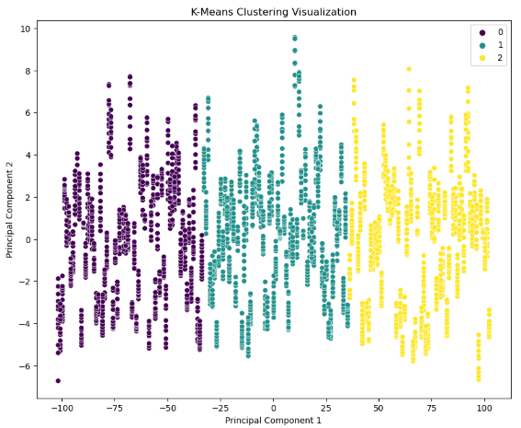
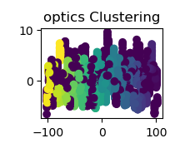
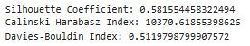
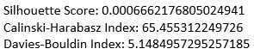
Comparatively, best model is k-means and model which has lower performance is optics

Slide 13
Application Deployment
Deployment Details:
Frameworks: Streamlit or Flask
User Features:
Interactive visualization of clusters.
Filtering options for variables or countries.
Include a screenshot or mock-up of the app interface.

Slide 14
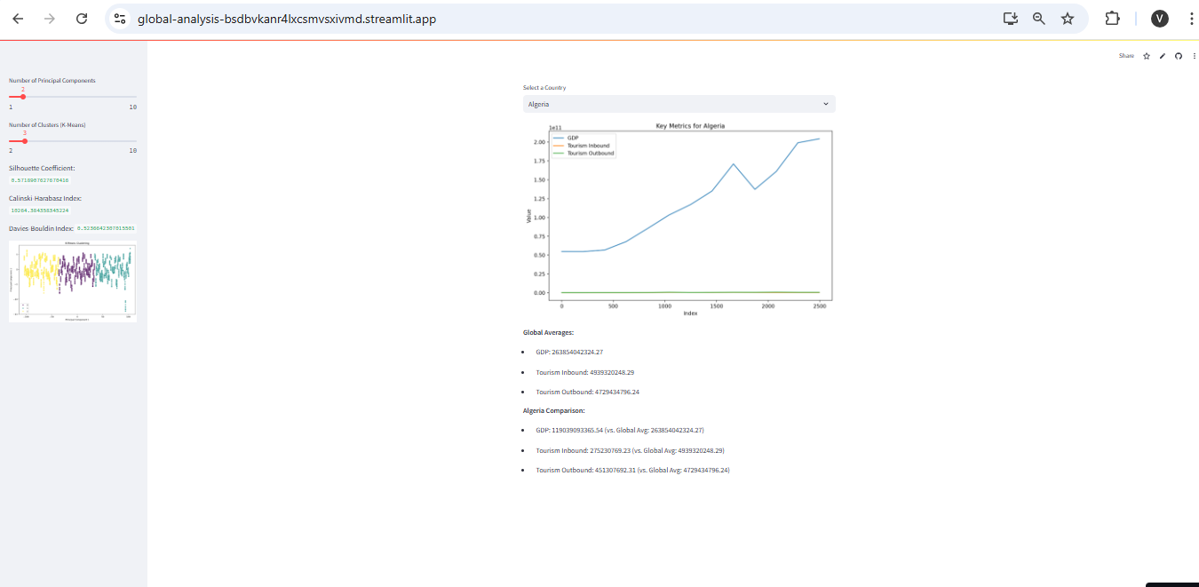
App Deployment with streamlit-
App URL: https://global-analysis-bsdbvkanr4lxcsmvsxivmd.streamlit.app/
APP UI:

Slide 15
Results and Analysis
Cluster Insights:
Highlight key trends and patterns from your clusters.
Show clusters on a world map or scatter plot (if applicable).
Comparative Analysis:
Summarize model performance metrics.
Explain why a particular model was selected for deployment.

Slide 16
Challenges faced-
Challenges:
Data Imbalance or Missing Values.
Selecting optimal number of clusters.
Solutions:
Imputation methods for missing data.
Use of metrics like the elbow method for determining clusters.

Slide 17
Conclusion-
Key Takeaways:
Clusters provide actionable insights into country-level development patterns.
The model and app enable intuitive exploration of global metrics.
Future Work:
Extend the analysis to include temporal trends.
Incorporate additional datasets for more robust insights.

